Slide 1




NEXT GEN EMPLOYABILITY PROGRAM
Creating a future-ready workforce
Team Members
College Name
Student Name :SUMATHI K
Student ID :510421104103
ARUNAI ENGINEERING COLLEGE

Slide 2

CAPSTONE PROJECT SHOWCASE
Project Title
Building Bus Reservation System using Python and Django
Abstract | Problem Statement | Project Overview | Proposed Solution | Technology Used | Modelling & Results | Conclusion

Slide 3
ABSTRACT: In this project,the bus reservation system was developed by using the python and Django web frameworks. It is the effective method,which was significant and in the recent trends for the online bus seating booking systems. In this bus reservation system was developed for the purpose of booking seats in the bus through online. This system consists of some features such as user registration,route management,ticket booking and finding buses. The purpose of this system is to create a user-friendly and efficient platform for managing bus bookings and reservations. This project represents that the modernized step towards the bus reservation process ,it is also offering the reliable and scalable solution for the transportation. It handles the Python programming lamguage,Django web framework,Sqlite,databases,data analysis and insights of the data enables the better decision making and some strategic planning.
Source :

Slide 4
Problem Statement: The problem statement of this bus reservation system is to develop a web-based reservation system using python and Django framework to do the process of booking bus tickets for passengers in an effective manner and in an user-friendly manner.
Source :

Slide 5
Project Overview: The Bus Reservation System is a web-based application developed using python and Django framework. It aims to simplify the process of booking bus tickets for passengers while administrators with tools to manage the details of buses,routes,bookings,and user accounts efficiently. It involves creating an web interface for users to book bus tickets seamlessly and the administrators will access to manage the routes,schedules and user information securely. In this system,the passengers can see real-time seat availability while making bookings to choose their seats conveniently so that’s why it is more reliable and user-friendly to the users.
Source :

Slide 6
Proposed Solution:
User authentication and authorization:
Users will register and login in the system.It will be utilized for user management.
Bus and route management:
Admin should enter the details of the bus such as bus route,departure time,and available seats.
Seat selection and Booking:
Passengers can search for the availability and select for the available buses based on the origin,destination and the date of travel.
Source :

Slide 7
Payment Integration:
Passengers can done their payments through the credit/debit cards for enabling secure payments.
Booking management:
Passengers can view their booking history and the cancellation processes and the upcoming trips also they can see.
Real-time seat availability:
Seat availability will be updated dynamically based on ongoing bookings and cancellations and admin dashboards for generating reports.
Source :

Slide 8
Future Enhancements:
Mobile application Development:
Develop a companion mobile application for iOS and android platforms,providing users with more flexibility and accessibility to book tickets on the go.
Social Media Integration:
Allow users to share their travel plans and booking confirmations on social media platforms,increasing brand visibility and user engagement. Enable users to share their booking status or upcoming travel plans on their social media profiles.
Source :

Slide 9

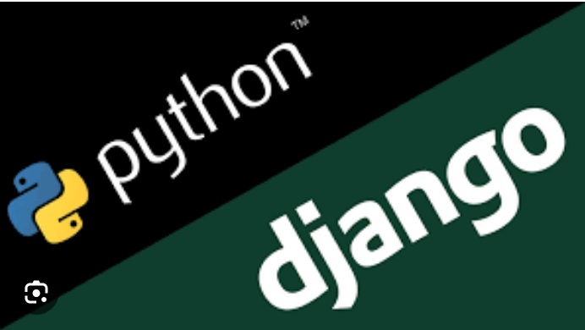
Technology Used
Front-end
Back-end
Source :

Slide 10
Modelling & Results: Identify entities: It typically identifies the entities such as buses,routes,bookings and users. Define attributes: for each entity,define the attributes are needed to be stored. Establish Realtionships: It determine the relationship between the entities.for example,if a bus may have multiple routes and it may be route multiple bookings. Model Implementations: It creates the models for each entity identified in the system. Results: we will effectively implement the system’s functionality and features.
Source :

Slide 11
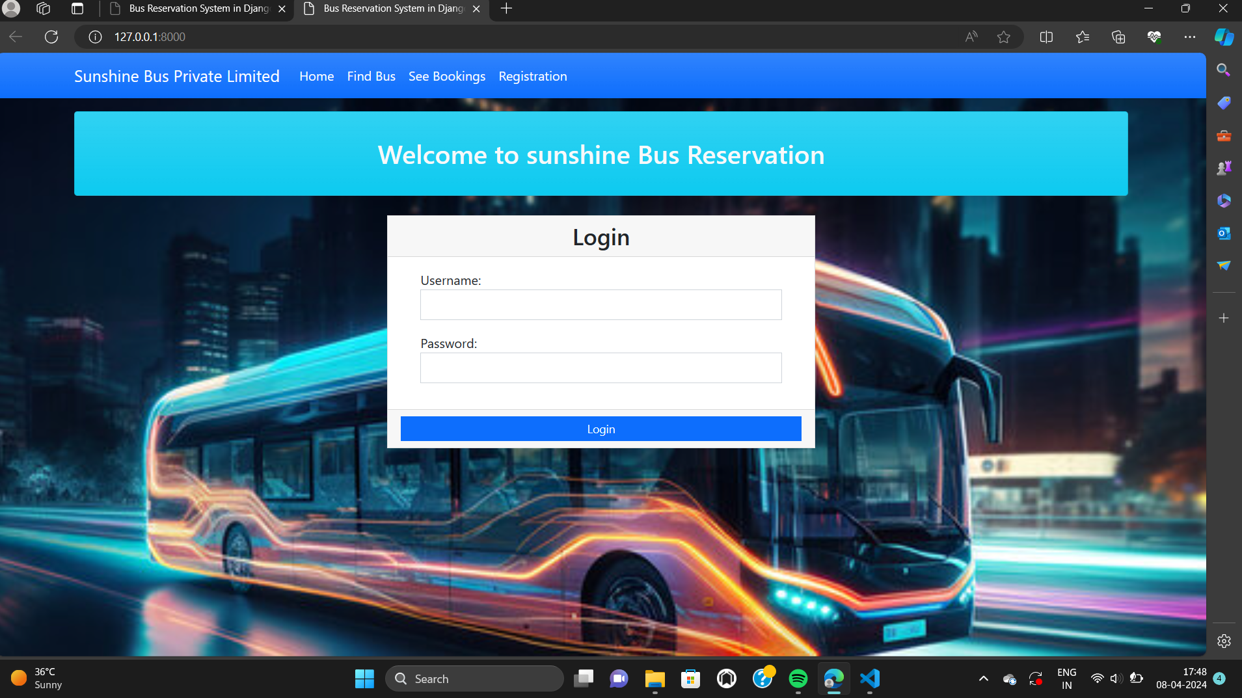
Homepage

Slide 12
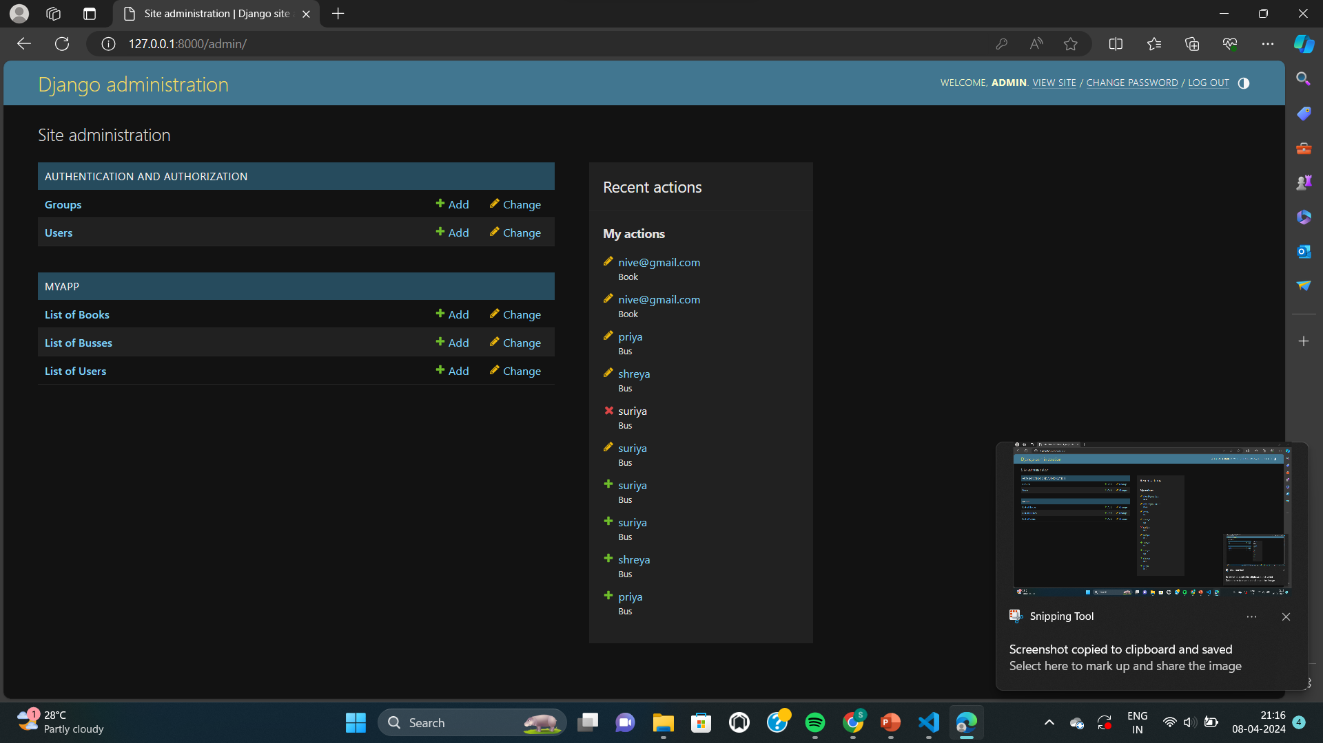
Django administration page

Slide 13
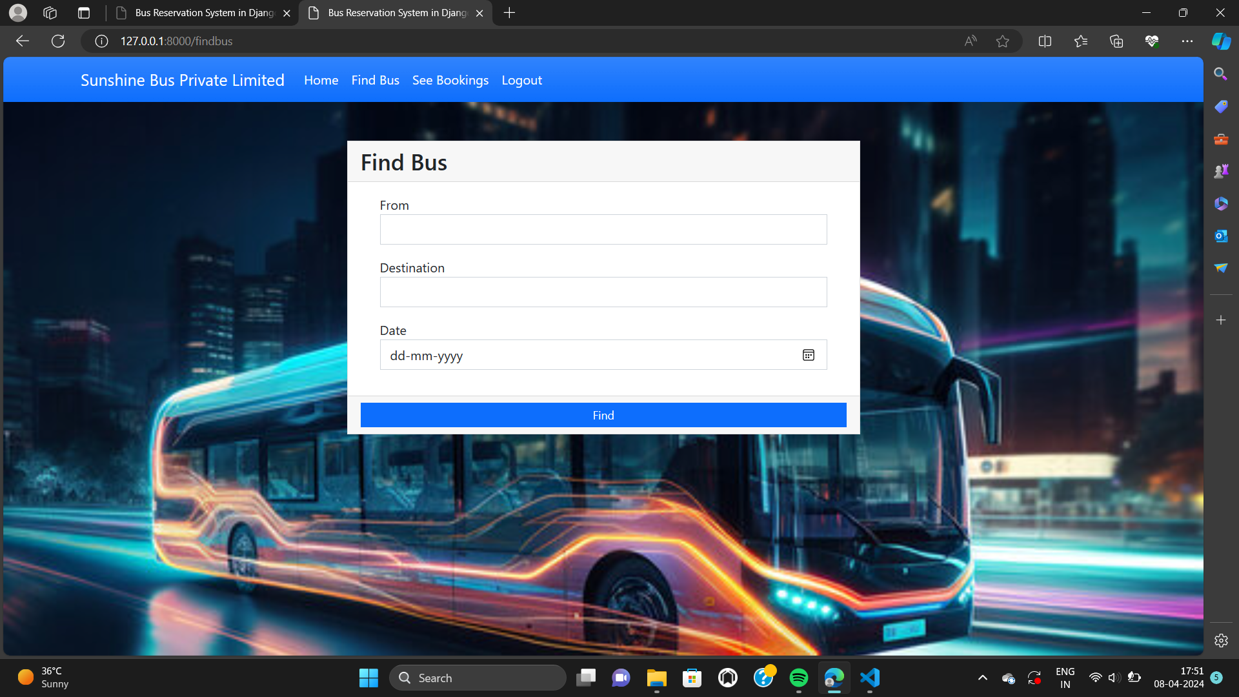
Finding the buses

Slide 14
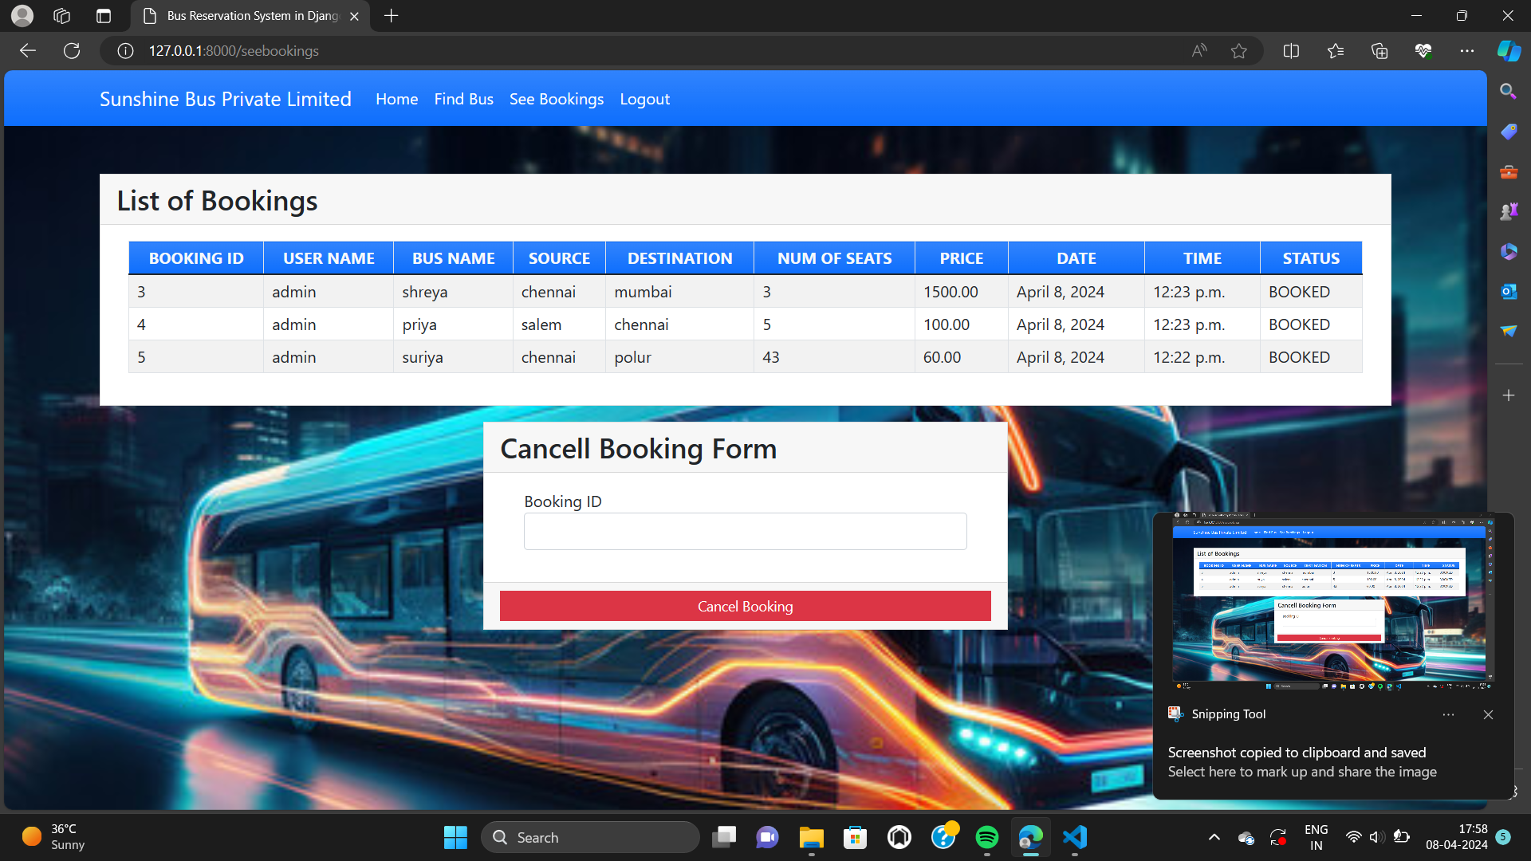
List of booking

Slide 15
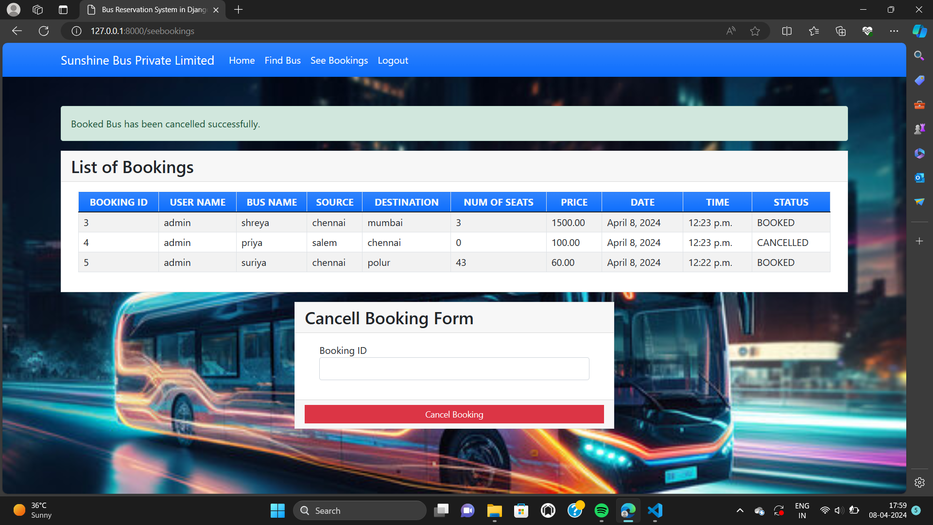
List of booking and cancellation of booking

Slide 16
Conclusion: In conclusion, the Bus Reservation System developed using Python and Django offers a comprehensive solution for streamlining the process of booking bus tickets. With its robust features, user-friendly interface, and efficient management tools, the system provides numerous benefits for both passengers and administrators. With continuous maintenance and support,the system can evolve to meet the changing requirements of the transportation for both the users and the administrators.
Source :

Slide 17
Thank You!
Notes:
Thank You !!

